Slide 1
AIR QUALITY MONITORING
Presented by
Gurusathiya T

Slide 2
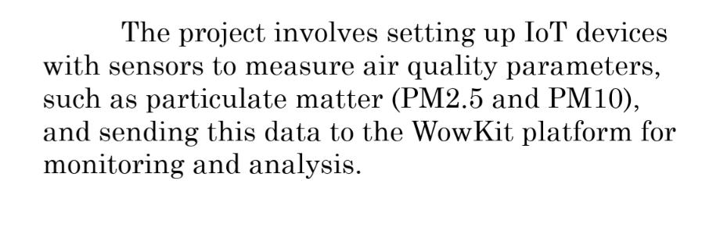
OVERVIEW

Slide 3
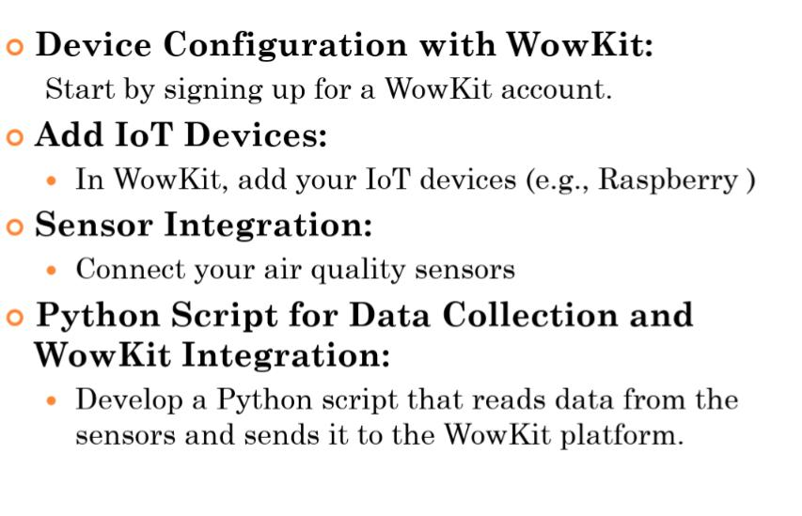
INVOLVING STEPS

Slide 4
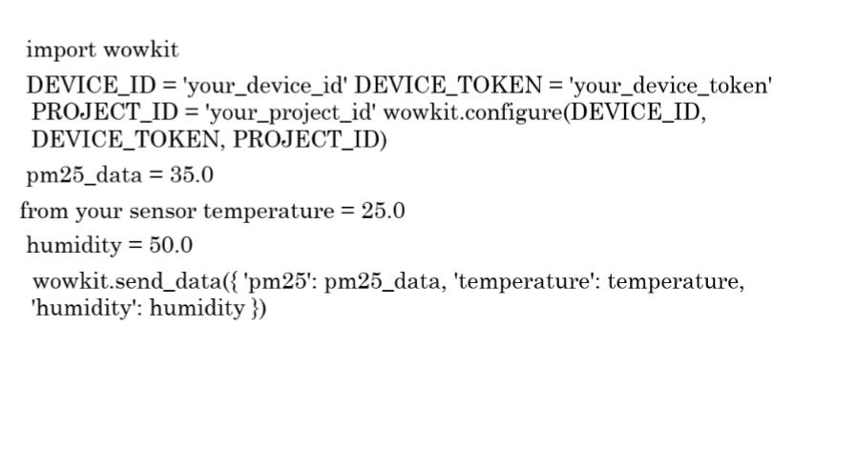
CODE TO EXECUTE

Slide 5
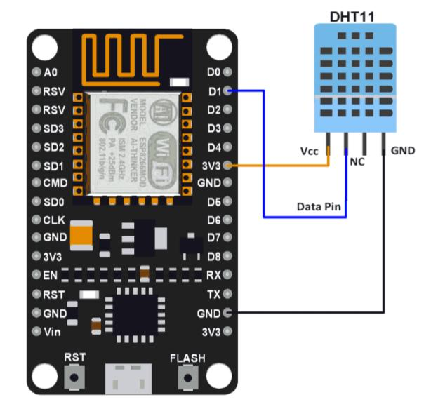
CONNECTION RESULT

Slide 6
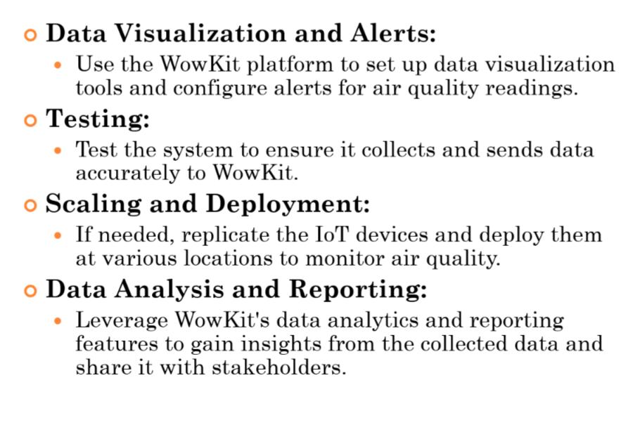
STEPS TO FOLLOW AFTER EXECUTION

